Slide 1
Digital Image Processing Technologies & Applications
Image Segmentation

Slide 2
Contents
Today we will begin looking at automated image analysis by image segmentation:
The segmentation problem
Edges detection
Edge linking and boundary detection

Slide 3
Segmentation
The purpose of image segmentation is to partition an image into meaningful regions with respect to a particular application.
Segmentation should stop when the objects of interest in an application have been isolated.
The segmentation is based on measurements taken from the image and might be grey level, colour, texture, depth or motion.

Slide 4
Segmentation
Typically it is the first step in any automated computer vision application.
Applications of image segmentation include:
Object detection for image analysis.
Object identification in a scene.
Path planning for a mobile robots.
Medical image segmentation for auxiliary diagnosis.
……

Slide 5
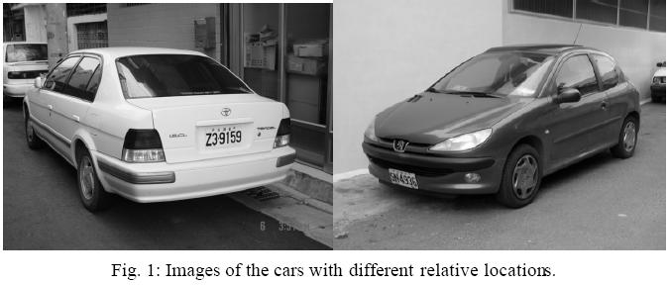
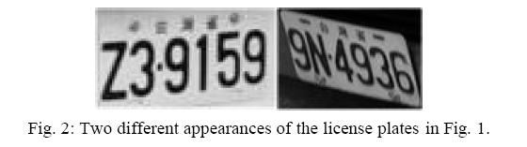
Segmentation

Slide 6
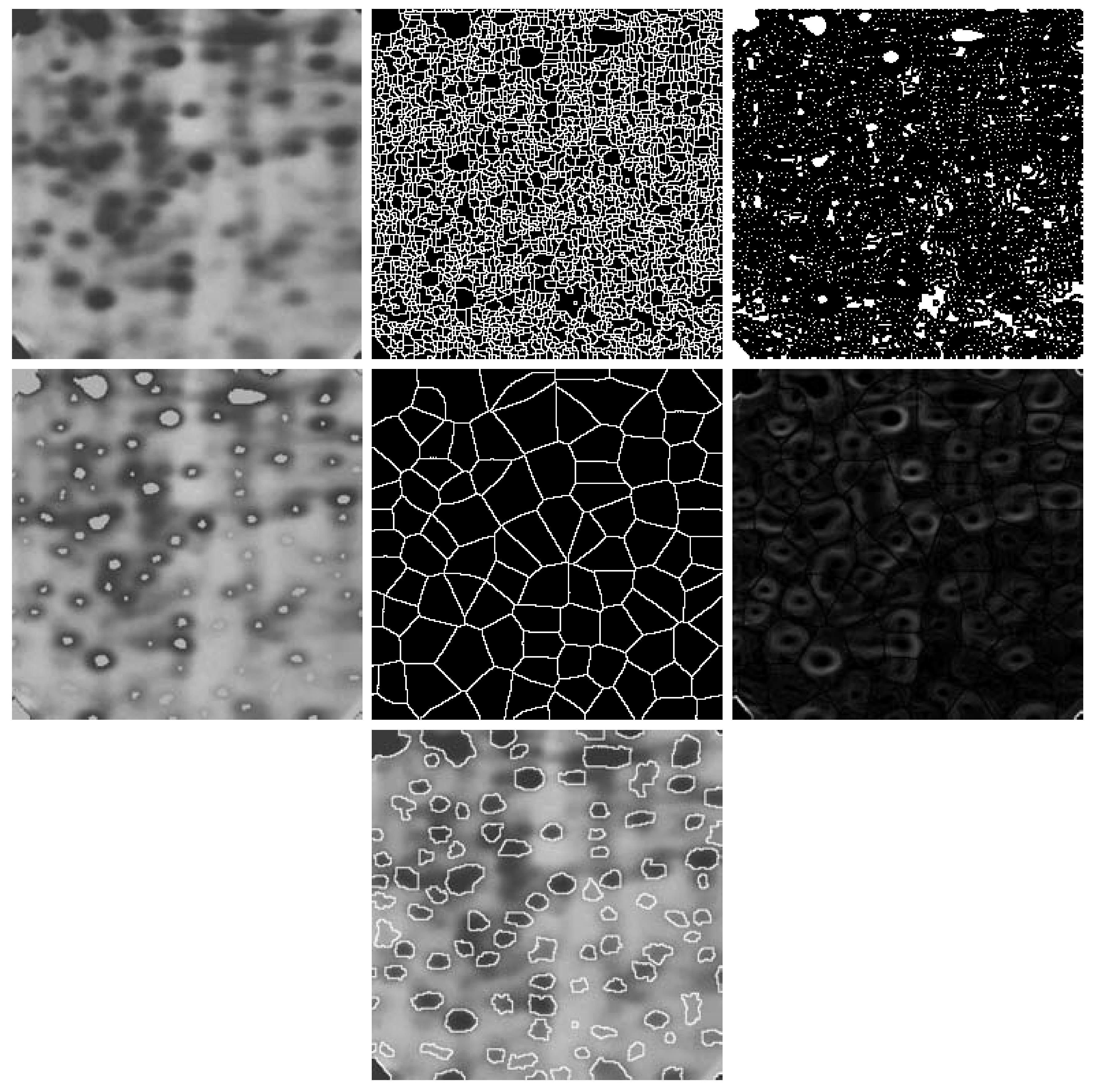
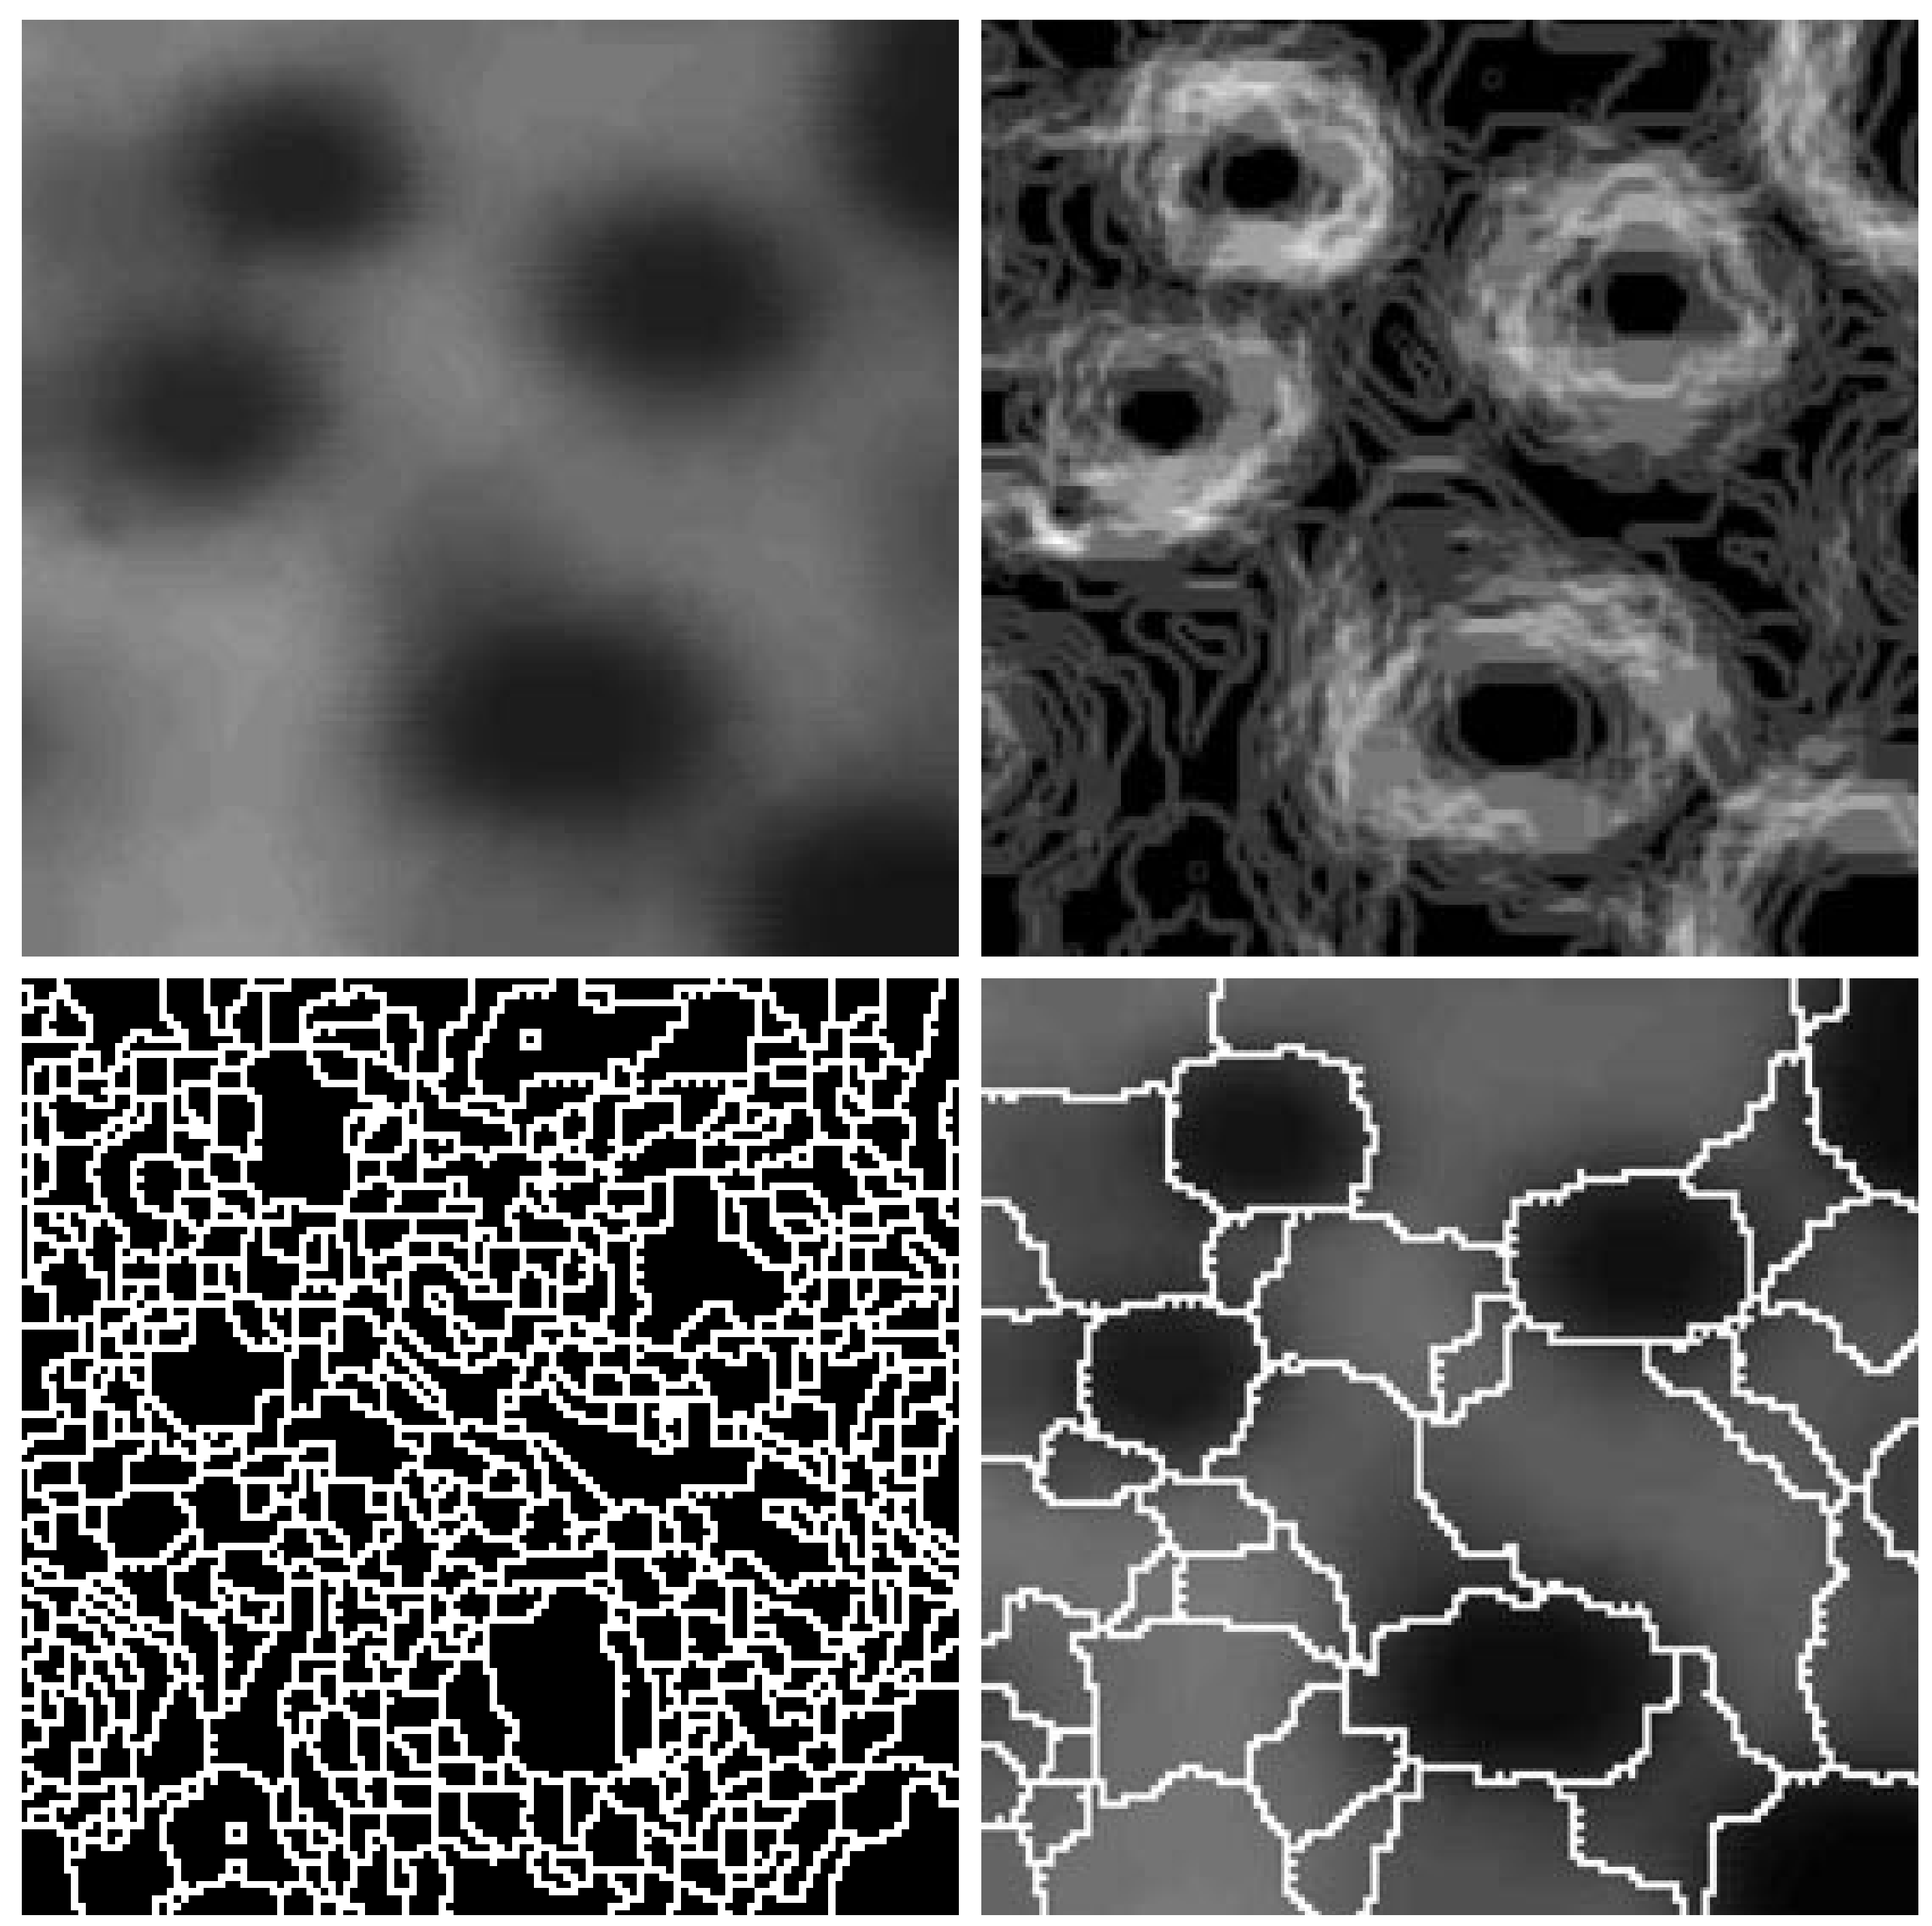
Segmentation

Slide 7
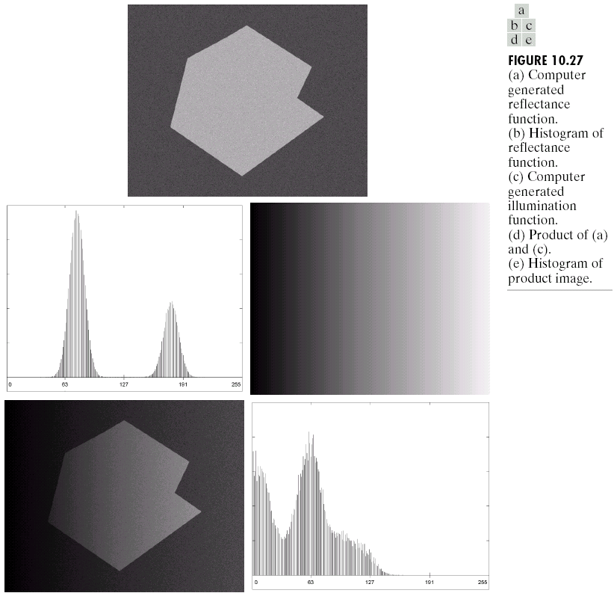
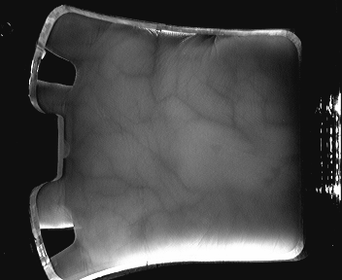
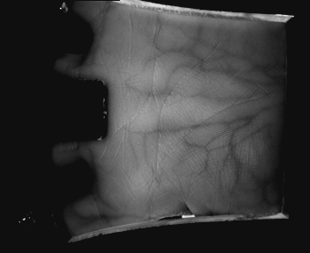
Segmentation
Image segmentation is one of the most difficult tasks in image processing.
Environment controllable: such as the industrial inspection applications.
Sensor controllable: such as autonomous target acquisition, or near infrared imaging.
Algorithm controllable.

Slide 8
Segmentation
Segmentation algorithms generally are based on of 2 basis properties of intensity values:
Discontinuity: to partition an image based on violent changes in intensity (such as edges).
Similarity: to partition an image into regions that are similar according to a set of predefined criteria.
Today, we will look at segmentation based on Discontinuity.

Slide 9
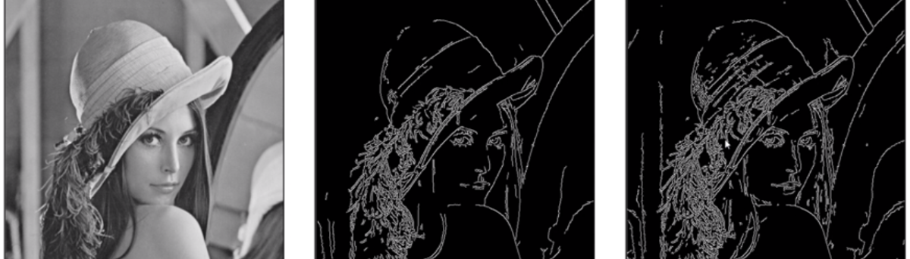
Detection Of Discontinuities
There are three basic types of grey level discontinuities that we tend to look for in digital images:
Points
Lines
Edges
We typically find discontinuities using masks and correlation.

Slide 10

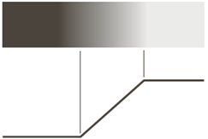
Edge Detection
The most common approach for detecting meaningful discontinuities in gray level.
An edge is a set of connected pixels that lie on the boundary between two regions
Step edge
（阶梯型边缘）
Ramp edge
（斜坡型边缘）
Roof edge
（屋顶型边缘）
Thin edge VS. Thick Edge!
The reasons for blur: Optics、sampling、illumination conditions

Slide 11
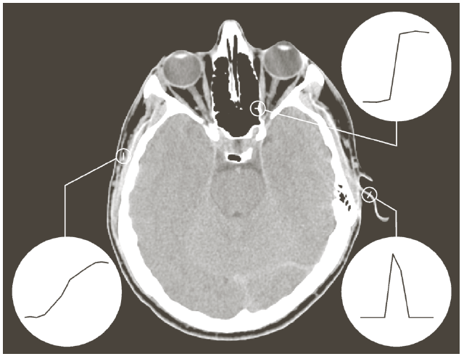
Edge Detection
实际图像中的边缘: 头部CT切片
Notes:
实际图像中的边缘不会和边缘模型一模一样。但是差不多。像这幅图像，头部CT的一个切片。上面3种边缘模型都可以找到，骨头（阶梯型）、肌肉（斜坡型）、耳朵（弹性软骨，屋顶型）

Slide 12
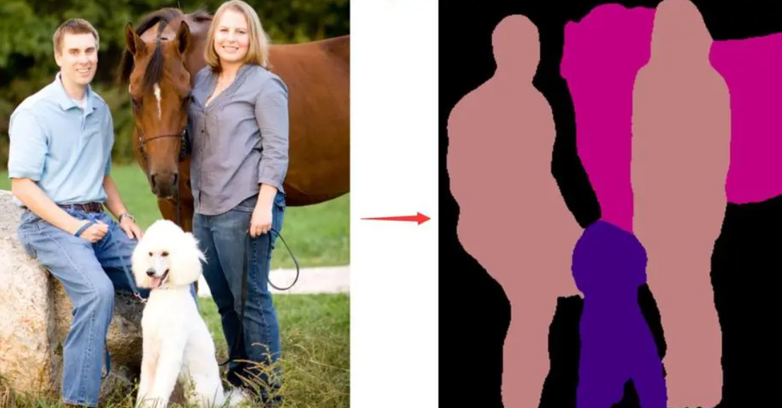
Edge Detection
Edge（边缘） and Region boundary（区域边界）:
An edge is a set of connected pixels that lie on the boundary between two regions.
An edge is a “local” concept whereas a region boundary, owing to the way it is defined, is a more global idea.

Slide 13
Spatial Differentiation
We discuss approached for implementing:
First-order derivative (Gradient operator)
Second-order derivative (Laplacian operator)
0 | 0 | 0 | 0 | 1 | 2 | 3 | 4 | 5 | 5 | 5 | 5
0 | 0 | 0 | 1 | 1 | 1 | 1 | 1 | 0 | 0 | 0
0 | 0 | 0 | 1 | 0 | 0 | 0 | 0 | -1 | 0 | 0

Slide 14


Edges & Derivatives
1st derivative
特点：对于左图，左侧的边是正的（由暗到亮），右侧的边是负的（由亮到暗）。对于右图，结论相反。常数部分为零。
2nd derivative
特点：二阶微分在亮的一边是负的，在暗的一边是正的。常数部分为零。

Slide 15
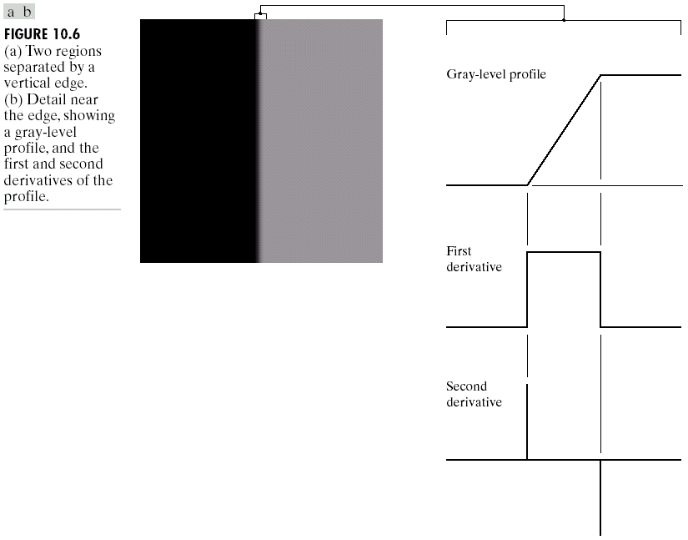
Edges & Derivatives
We can see how derivatives are used to find discontinuities1st derivative tells us where an edge is. 2nd derivative can be used to show edge direction.

Slide 16
Edge Detection
Second derivatives:
Produces 2 values for every edge in an image (an undesirable feature).
An imaginary straight line joining the extreme positive and negative values of the second derivative would cross zero near the midpoint of the edge (Zero-crossing property)
Quite useful for locating the centers of thick edges.
We will talk about it again later.

Slide 17
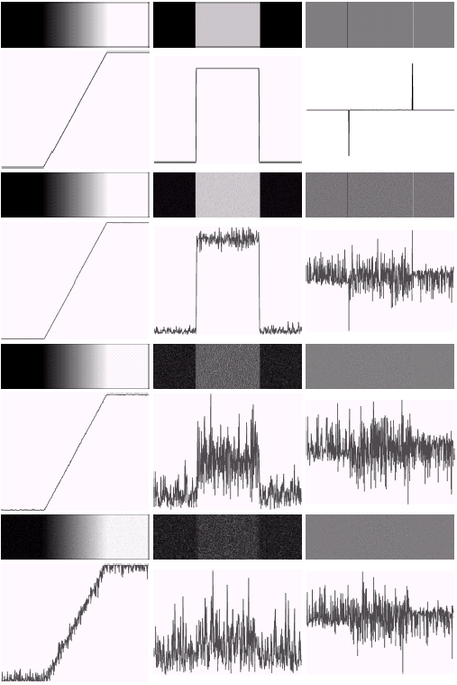
Derivatives & Noise
Derivative based edge detectors are extremely sensitive to noise.
First column: images and gray-level profiles of a ramp edge corrupted by random Gaussian noise of mean 0 and σ= 0.0, 0.1, 1.0, and 10.0.
Second column: first derivative images and gray-level profiles.
Third column: second first derivative images and gray-level profiles.

Slide 18
Derivatives & Noise
Keep in mind
Fairly little noise can have such a significant impact on the two key derivatives used for edge detection in images.
Image smoothing should be serious consideration prior to the use of derivatives in applications where noise is likely to be present.

Slide 19
Derivatives & Noise
Edge point
To determine a point as an edge point:
The transition in grey level associated with the point has to be significantly stronger than the background at that point.
Use threshold to determine whether a value is “significant” or not.
The point’s two-dimensional first order derivative must be greater than a specified threshold.
Firstly, we discuss Gradient operators and Laplacian operators

Slide 20
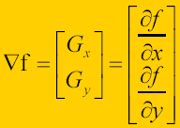
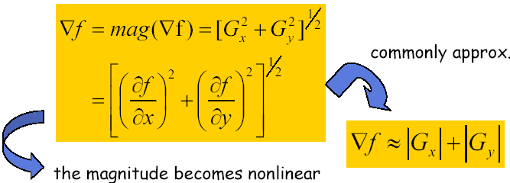
Gradient Operator
The gradient vector points in the direction of maximum rate of change of f at (x, y).
First derivatives are implemented using the magnitude of the gradient.

Slide 21
Gradient Direction
Let a(x, y) represent the direction angle of the vector ▽f at (x, y):
a(x, y)=tan⁻¹(G_{y} / G_{x})
The direction of an edge at (x, y) is perpendicular to the direction of the gradient vector at that point.

Slide 22
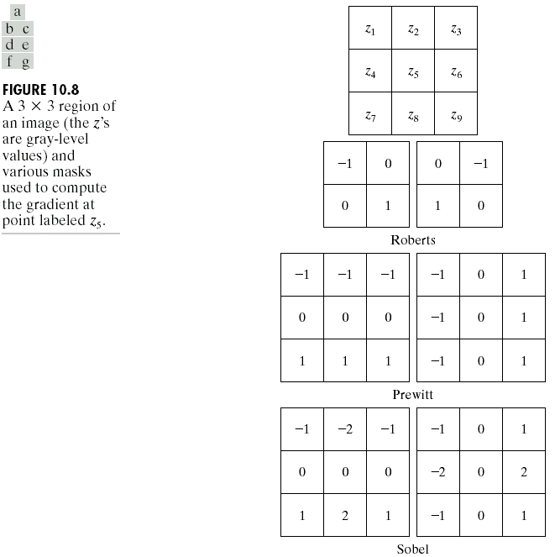
Common Edge Detectors
Given a 3*3 region of an image the following edge detection filters can be used

Slide 23
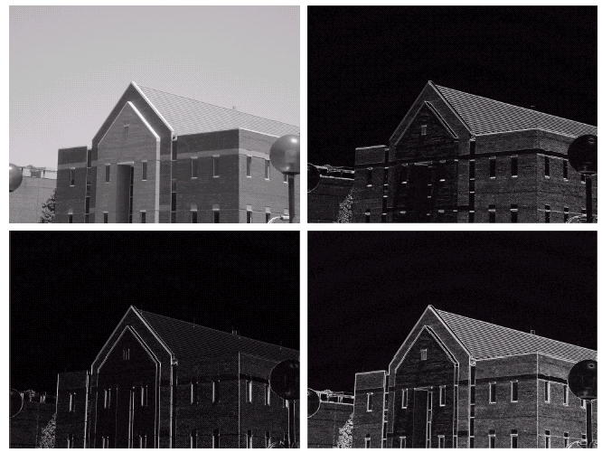
Edge Detection Example
gradient.m
Original Image
Horizontal Gradient Component
close all;
name='Fig1006a.tif';
x=imread(name);
[m,n]=size(x);
x1=double(x);
sobelx=[-1 -2 -1;
0 0 0;
1 2 1];
sobely=[-1 0 1;
-2 0 2;
-1 0 1];
xx=filter2(sobelx,x1);
figure, imshow(xx, []);
yy=filter2(sobely,x1);
figure, imshow(yy, []);
x2=abs(xx)+abs(yy);
figure, imshow(x2, []);
Vertical Gradient Component
Combined Edge Image

Slide 24
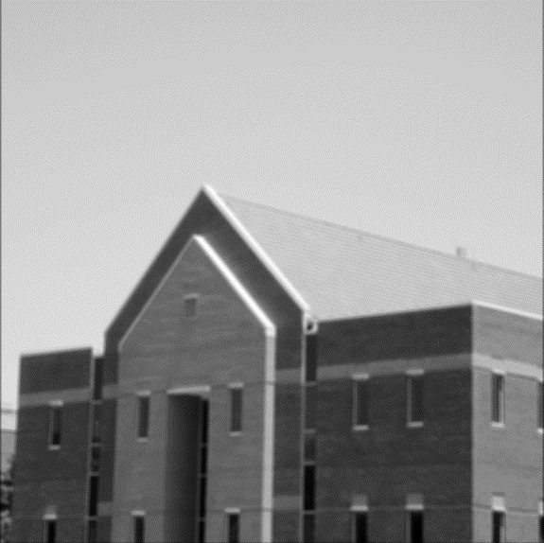
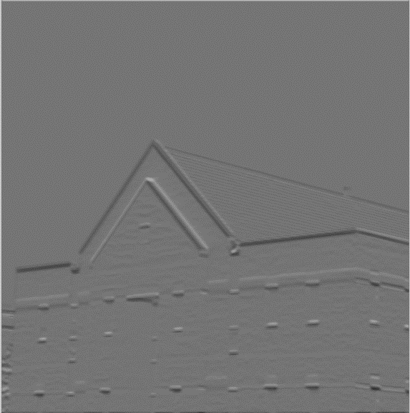
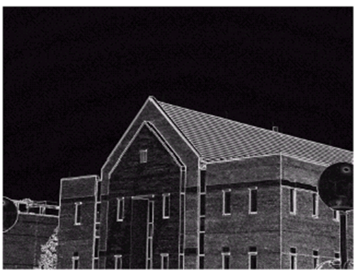
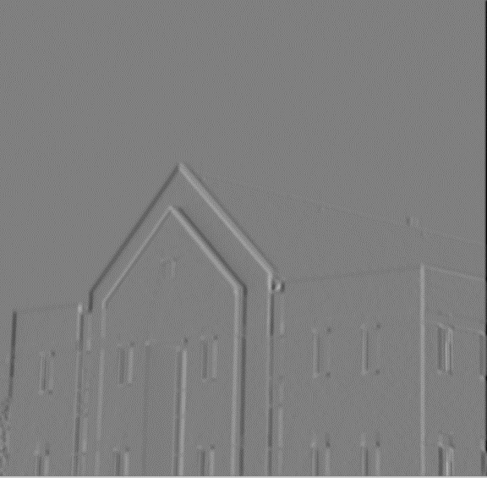
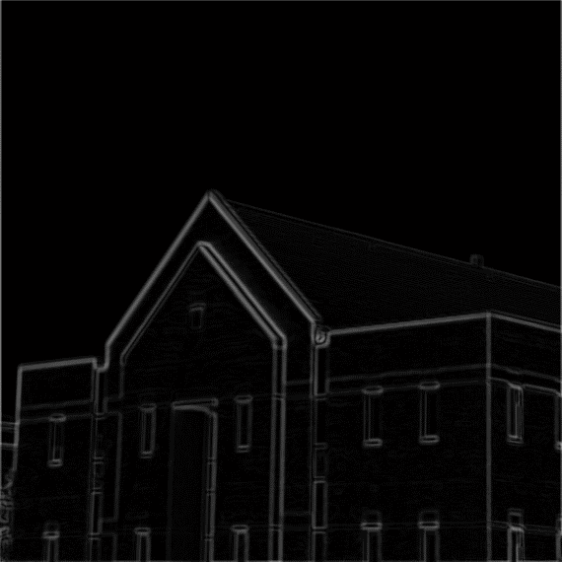
Edge Detection Example
Original Image
Horizontal Gradient Component
Often, problems arise in edge detection is that there is too much detail.
One way to overcome this is to smooth images prior to edge detection.
Vertical Gradient Component
Combined Edge Image

Slide 25
Edge Detection Example
x=imread(name);
x1=double(x); imshow(x);
[m,n]=size(x);
sm=ones(5,5);
x1=filter2(sm,x1);
sobelx=[-1 -2 -1; 0 0 0; 1 2 1];
sobely=[-1 0 1; -2 0 2; -1 0 1];
xx=filter2(sobelx,x1); figure, imshow(xx, []);
yy=filter2(sobely,x1); figure, imshow(yy, []);
x2=abs(xx)+abs(yy);
figure, imshow(x2, []);
th=sum(sum(x2))/(m*n);
temp=find(x2<1.4*th);
x2(temp)=0;
temp=find(x2>=1.4*th);
x2(temp)=255;
figure, imshow(x2, []);
gradient2.m
Smoothing+Threshold

Slide 26
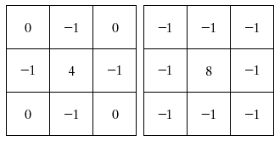
Laplacian
The Laplacian is seldom used in practice, because:
It is unacceptably sensitive to noise (as second-order derivative)
It produces double edges
It is unable to detect edge direction

Slide 27
Laplacian
An important use of the Laplacian:
To find the location of edges using its zero-crossings property.
Plus, the Laplacian plays only the role of detector of whether a pixel is on the dark or light side of an edge.
Usually when used for edge detection the Laplacian is combined with a smoothing Gaussian filter.

Slide 28
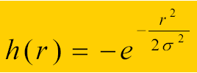
Laplacian of Gaussian
Laplacian combined with smoothing as a precursor to find edges via zero-crossing.
2D Gaussian function
Where r²=x²+y², and σ is the standard deviation.
Convolving this function with an image blurs the image, with the degree of blurring being determined by the value of standard deviation.

Slide 29
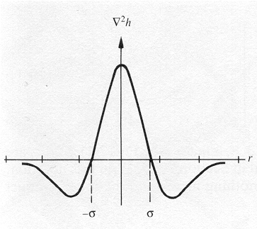
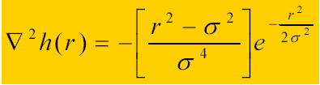
Laplacian of Gaussian
The Laplacian of the above Gaussian is:
where r² = x² + y².
σ determines the degree of blurring that occurs.

Slide 30

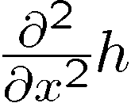
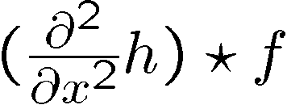
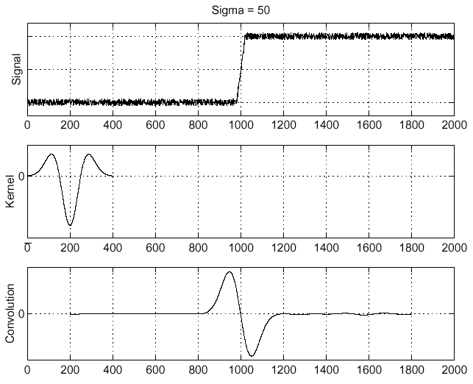
Laplacian of Gaussian (LoG)
Laplacian of Gaussian
Laplacian of Gaussian operator
Where is the edge?
Zero-crossings of bottom graph !

Slide 31
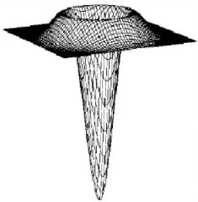
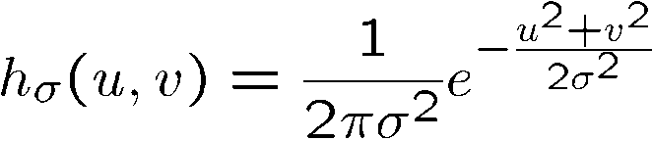
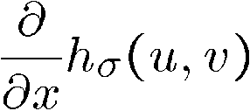
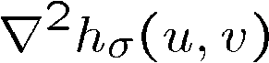
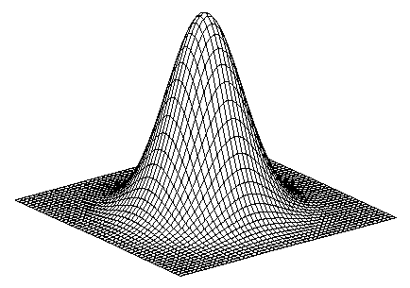
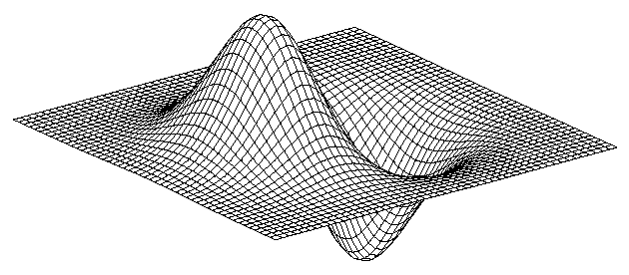
Laplacian Of Gaussian
Gaussian
Derivative of Gaussian (DoG)
Laplacian of Gaussian
Mexican Hat (Sombrero)
The Laplacian of Gaussian (LoG, or Mexican hat) filter uses the Gaussian for noise removal and the Laplacian for edge detection

Slide 32
Laplacian Of Gaussian
Remarks:
Because the second derivative is a linear operation, convolving an image with LoG is the same as convolving the image with the Gaussian smoothing function first, and then computing Laplacian.
The purpose of Gaussian in the LoG is to smooth the image.
The purpose of Laplacian is to establish the location of edges (zero crossing)

Slide 33
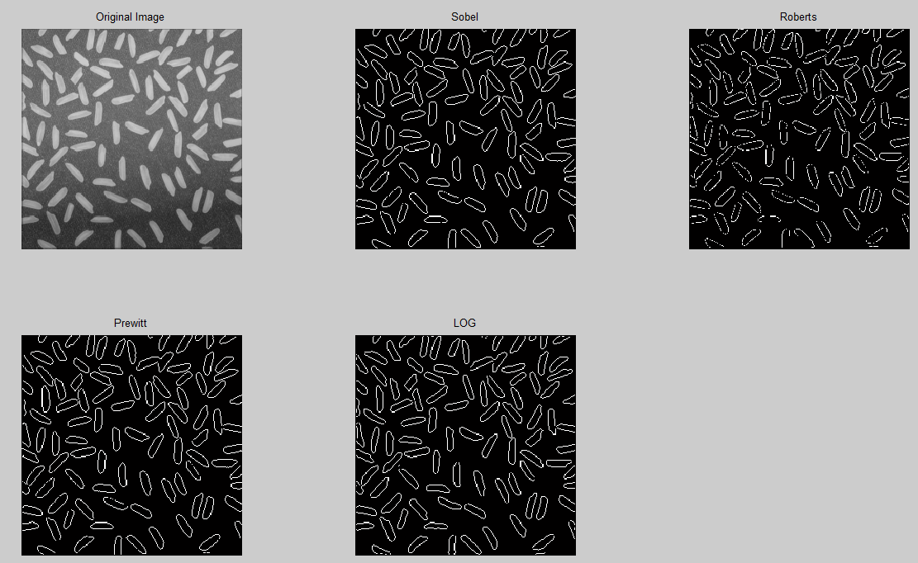
Operators in MATLAB

Slide 34
Operators in MATLAB
I = imread('Fig0926(a)(rice).tif');
BW1 = edge(I,'sobel'); %Sobel operators
BW2 = edge(I,'roberts'); %Roberts operators
BW3 = edge(I,'prewitt'); %Prewitt operators
BW4 = edge(I,'log'); %LOG operators
subplot(2,3,1),imshow(I), title('Original Image')
subplot(2,3,2),imshow(BW1), title('Sobel')
subplot(2,3,3),imshow(BW2), title('Roberts')
subplot(2,3,4),imshow(BW3), title('Prewitt')
subplot(2,3,5),imshow(BW4), title('LOG')

Slide 35
Optimal Edge Detection: Canny
John Canny:
A Computational Approach to Edge Detection, IEEE Transactions on Pattern Analysis and Machine Intelligence ( Volume: PAMI-8, Issue: 6, Nov. 1986 ).
Optimal edge detector should have 3 properties:
Good SNR: Filter responds to edge, not noise.
Good Localization: detected edge near true edge.
Single Response: one per edge.

Slide 36
Optimal Edge Detection: Canny
Gaussian filtering
G’(x,y)
Original image
G(x,y)
B(x,y)
1st derivative
Non-maxima Suppression
Final Edge image
Double threshold to link the final edge
Initial edge

Slide 37
Optimal Edge Detection: Canny
1. Gaussian function: noise removing
2. 1st derivative (soble, Prewitt or Roberts…)
n: the size of the Gaussian filter.

Slide 38
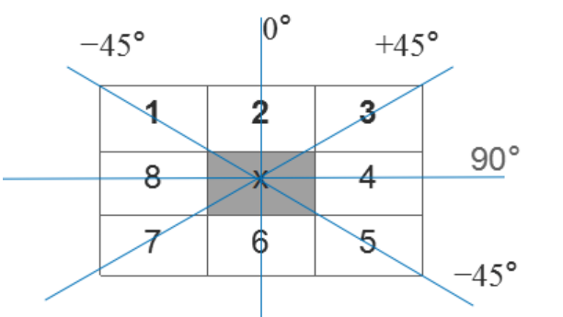
Optimal Edge Detection: Canny
3. Non-maxima Suppression (NMS): It is not enough to confirm the edge by the global gradient. We can keep the local maxima gradient to find the edge (find the max gradient alone the angle, it is the edge point).
4 | 3 | 2
1 | M | 1
2 | 3 | 4
在每一点上，邻域中心 x 与沿着其对应的梯度方向的两个像素相比，若中心像素为最大值，则保留，否则中心置0，这样可以抑制非极大值，保留局部梯度最大的点，以得到细化的边缘。
划重点：沿梯度方向对幅值进行非极大值抑制，而非边缘方向.

Slide 39
Optimal Edge Detection: Canny
4. Double threshold：
Usually, single threshold cannot get good results, since the perfect threshold is difficult to choose.
The double thresholds are the better way: th1, th2, th1=0.4th2
Then we can get two edge image: I1, I2, the I2 is gotten by the bigger threshold th2, which has removed more noise, and also loses some useful edge. I1 contains more detail edge, so we can combine them together.

Slide 40
Optimal Edge Detection: Canny
5. Edge link
a. Scan I2, when find a none zero point p, take p as a start point to track the edge to its end point q;
b. In I1, consider the same location (q’) of q(in I2) and its corresponding 8-neighbourhood, if there is any none zero point, then add it into I2, and mark is as r, then take r as a start point, repeat step a until no more points can be found;
c. Until now, we finished the edge detection which include point p, and mark it as scanned. Then, go to find next edge by step a, b, and c.

Slide 41
Optimal Edge Detection: Canny
th1----→Image1
Scan Image2
非零轮廓线终点
Find edge point in Image1
th2----→Image2
补充到图像2中作为新的起点继续遍历

Slide 42
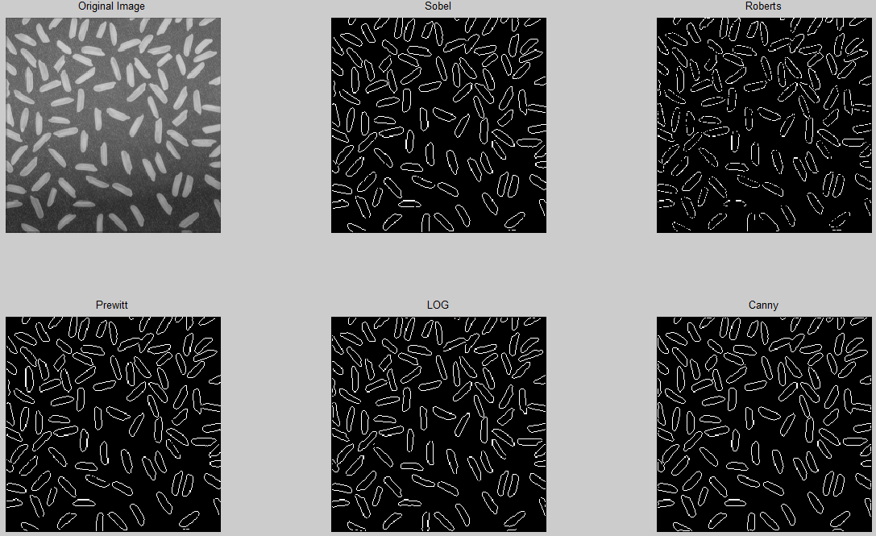
Optimal Edge Detection: Canny

Slide 43
Edge Link and Boundary Detection
Edge detection algorithm are followed by linking procedures to assemble edge pixels into meaningful edges.
Basic approaches:
Local processing
Global processing via the Hough Transform
Robert Operator

Slide 44
Local Processing
Analyze the characteristics of pixels in a small neighborhood (e.g. 3X3, 5X5) about every edge pixels (x, y) in an image.
All points that are similar according to a set of predefined criteria are linked, forming an edge of pixels that share those criteria.
The strength of the response of the gradient operator
An edge pixel with coordinates (x₀, y₀) in a predefined neighborhood of (x, y) is similar in magnitude to the pixel at (x, y) if
The direction of the gradient vector
An edge pixel with coordinates (x₀, y₀) in a predefined neighborhood of (x, y) is similar in angle to the pixel at (x, y) if

Slide 45
Local Processing
Criteria
A point in the predefined neighborhood of (x, y) is linked to the pixel at (x, y) if both magnitude and direction criteria are satisfied.
The process is repeated at every location in the image.
A record must be kept.
Simply by assigning a different gray level to each set of linked edge pixels.

Slide 46
Local Processing
Use vertical and horizontal Sobel operators.
Link conditions: gradient value > 25; gradient direction difference < 15.
Eliminates isolated short segments, link little breaks.

Slide 47
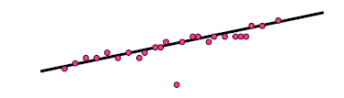
Global Processing
Global Processing
Find lines, curves, or parts of lines or curves in an input image.
Such an image might be the output of a edge detector discussed in the previous lectures.
Model fitting – Given a group points, find the curve or line that explains the data points best.
For example: Line.

Slide 48
Global Processing
Solution:
Find all lines determined by every pair of points
Find all subsets of points close to particular lines
Involves: n(n-1)/2 ~ n² lines
(n-2)(n(n-1))/2 ~ n³ computations
for comparing every point to all lines.
*A solution: Hough Transform

Slide 49
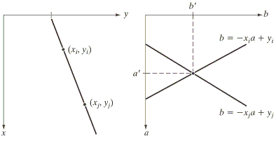
Hough Transform
Hough 1962
Hough Transform
Original space
Parameter Space
Points-Lines Duality

Slide 50
Hough Transform
Consider a straight line. The HT maps all the points on the line onto a single point in the parameter space.
A line in image space and a point in parameter space are a Hough Transform pair.
A point in image space and a line in parameter space are a Hough Transform pair.
Original space
Parameter Space

Slide 51
Hough Transform
Calculating steps of hough transform:
In parameter space, quantize a and b, and give out (a_{min}, a_{max}) and (b_{min}, b_{max}).
Set an accumulator A: A is A(a_{min}:a_{max}, b_{min}:b_{max}),set A to zero at the beginning.
For a given point (x_{i}, y_{i}) in the original space, let a equal to each allowed values on the a-axis, and solve for the corresponding b using the equation:
The resulting b are then rounded off to the nearest allowed value in the b-axis. If a choice of a_{p} results in solution b_{q}, we let A(p,q)=A(p,q)+1
At the end of this procedure, a value Q in A(i,j) corresponds to Q points in the xy space lying on the line y=a_{i}x+b_{j}.

Slide 52
Hough Transform

Slide 53
Hough Transform
Quantize the parameter space (an array) and let the generation of a line be the increment of a counter at all cells in the parameter space that lie along the line.
Histogram the resulting parameter space (accumulators).
Peaks in this accumulator array occur at parameter locations corresponding to lines with significant support.

Slide 54
Hough Transform
a can be huge for near vertical lines, and there is no representation for a vertical line.
Solution – using polar representation for lines.
In polar representation, a point in the image correspond to sinusoidal curve in the parameter space.
-90<= θ <=90
x,y
p

Slide 55
Hough Transform

Slide 56
Hough Transform

Slide 57
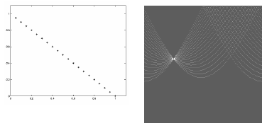
Hough Transform
Hough Transform: 20 colinear points
, θ representation of line
Maximum accumulator value is 20

Slide 58
Hough Transform
Hough Transform: “Noisy line”
• , θ representation of line
• Maximum accumulator value is 6

Slide 59
Hough Transform
Now return to the edge linking problem:
Compute the gradient of an image and threshold it to obtain a binary image.
Specify subdivisions in the parameter plane.
Examine the counts of the accumulator cells for high pixel concentrations.
Examine the relationship (principally for continuity) between pixels in a chosen cell.

Slide 60
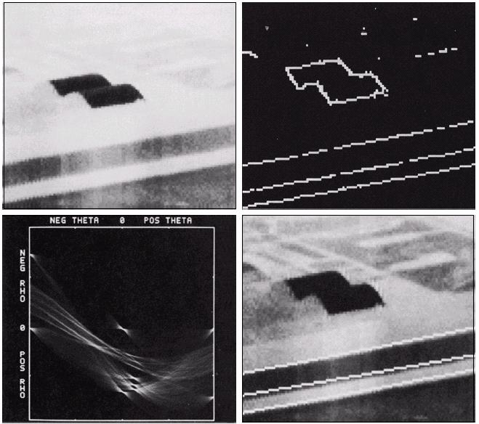
Hough Transform
They belonged to one of the three accumulator cells with the highest count
No gaps were longer than five pixels

Slide 61
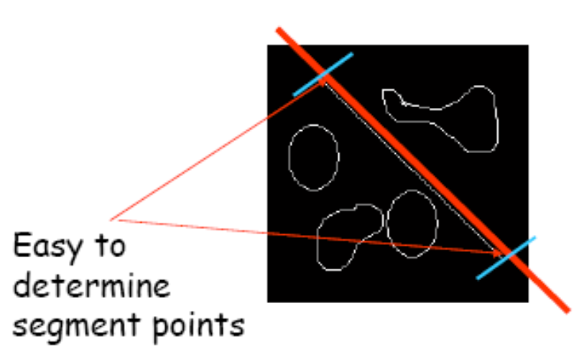
Hough Transform
Note: the parametric solution represents the whole line and not the segment

Slide 62
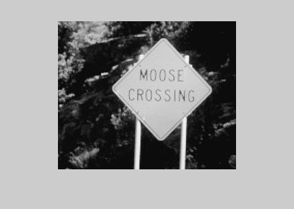
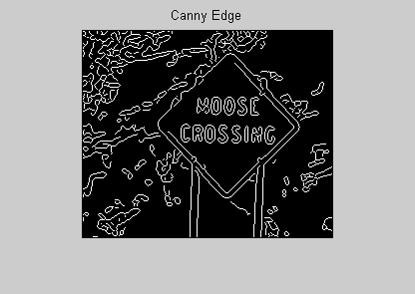
Hough Transform
Gray Scale Image Edge Image (Canny)

Slide 63
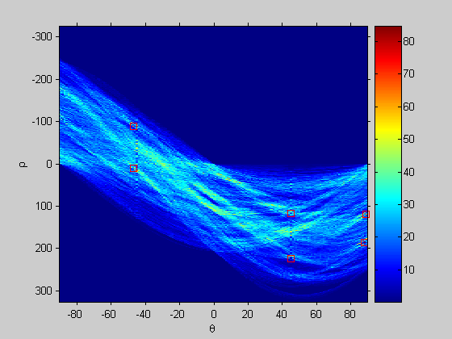
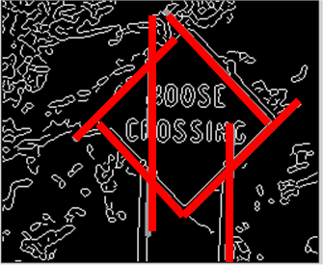
Hough Transform

Slide 64
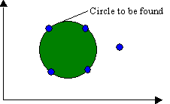
Hough transform detecting circles
Although the focus so far has been on straight lines, the hough transform is applicable to any function of the form g(v, c)=0, where v is a vector of coordinates and c is a vector of coefficients. For example, the points lying on the circle
can be detected by using the approach just discussed.
The only difference is that there
are three parameter.

Slide 65
Hough transform detecting circles
The procedure is to increment c₁ and c₂, solve for the c₃ that satisfy:
Then updated the accumulator corresponding to the cell associated with the triplet (c₁,c₂,c₃)
Clearly, the complexity of the Hough transform is proportional to the number of coordinates and coefficients in a given functional representation.

Slide 66
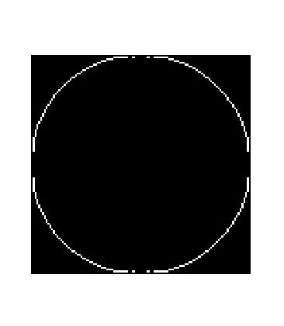

Hough transform detecting circles
name='circle2.tif';
x=imread(name);
y=edge(x,'canny');
Input image

Slide 67
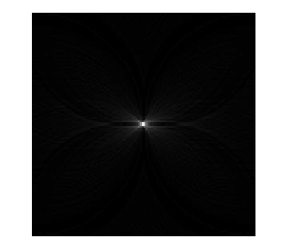
Hough transform detecting circles
Find the center of the circle (the biggest value in the accumulator), since the radius is known, then we can find the circle we want.
The center of the circle (the biggest value in the accumulator)
Testhoughcircle.m

Slide 68

Hough transform detecting circles
b
a
(x_{o}, y_{o})
Min E=(x-x_{o})²/a²+(y-y_{o})²/b²-1

Slide 69
Hough Transform
The original Hough transform was designed to detect straight lines and curves.
This method can be used if analytic equations of object borderlines are known.
Since each point is handled independently, parallel implementations are possible.
It becomes difficult when the dimension of the parameter space is large.
Now hardware of Hough transform for line detection is available.

Slide 70
Summary
Next lecture we will look at:
Thresholding
Region based segmentation
Morphological watersheds approach

